Slide 1

Data Visualization
Understanding Data Through Visual Representation
Presented by Tech Kares
Team Members :
Dhnanush H Dilan B
Karthik
Sumaira Marzuqa Bashir Heera
Shifali K Salian

Slide 2
What is Data Visualization?
Data Visualization is the graphical representation of information and data.
It helps users understand patterns, trends, and relationships in data.
Visual formats like charts, graphs, and plots make complex data easy to interpret.
Why it matters:
Faster understanding than raw tables.
Better decision making.
Widely used in Data Science, Machine Learning, Finance, and Research.

Slide 3
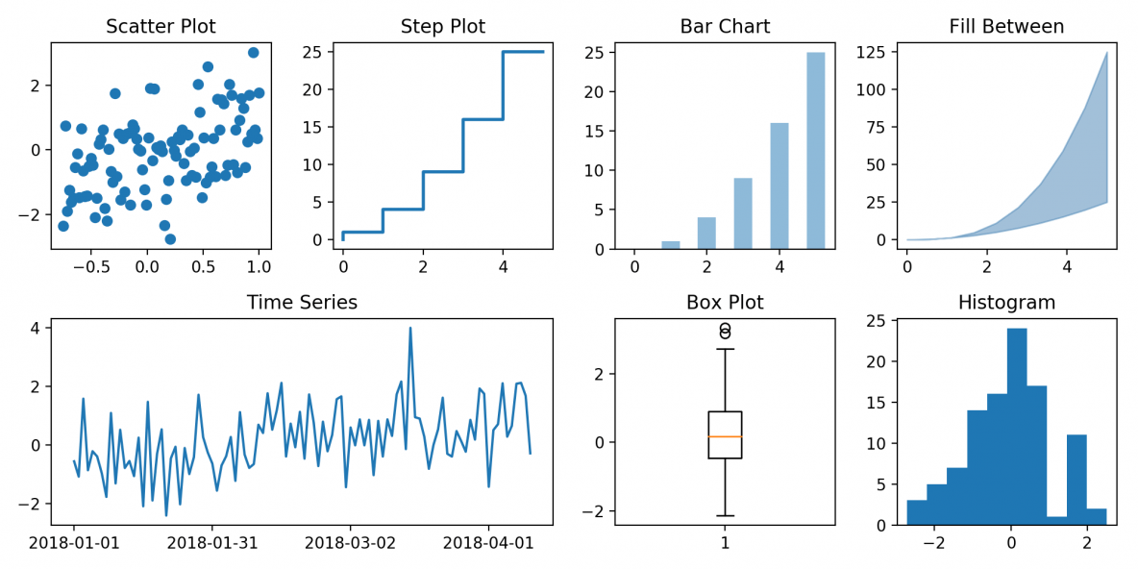
Introduction to Matplotlib
Matplotlib is a core Python library for creating visualizations.
It provides full control over plot appearance.
Used for:
Data exploration
Reporting
Academic and industry analysis
Key Features:
Supports line plots, bar charts, scatter plots, and more.
Works well with NumPy and Pandas.

Slide 4
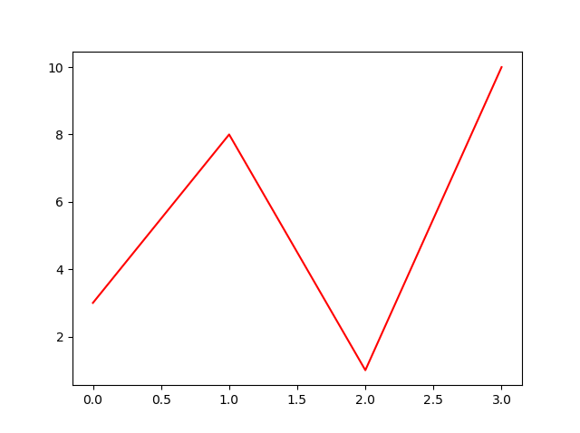
Line Plots :
A line plot connects data points using straight lines.
Mainly used to show trends over time or ordered data.
Why Line Plots Exist:
Humans understand trends visually faster.
Easy to identify increase, decrease, or stability.
Common Uses:
Stock prices
Performance tracking
Time-series analysis

Slide 5
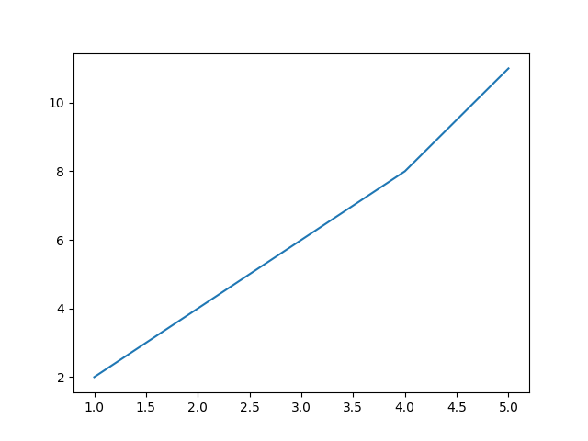
Line Plot – Example Code
Output
import matplotlib.pyplot as plt
x = [1, 2, 3, 4, 5]
y = [2, 4, 6, 8, 11]
plt.plot(x, y)
plt.show()
Explanation:
x represents the input values
y represents the output values
plt.plot() creates the line graph

Slide 6
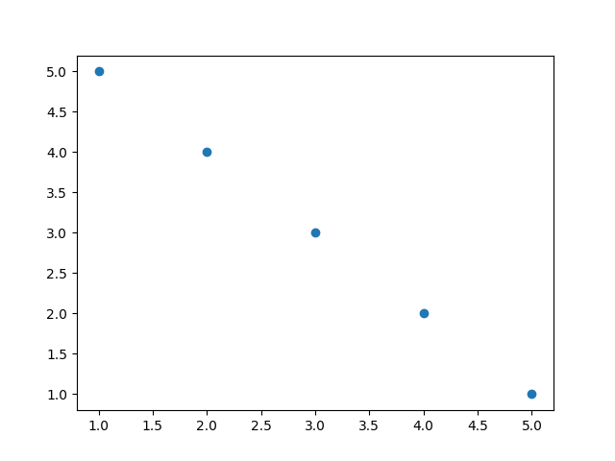
Scatter Plots
Example Code
A scatter plot displays individual data points.
No lines are drawn between points.
import matplotlib.pyplot as plt
x = [1, 2, 3, 4, 5]
y = [5, 4, 3, 2, 1]
plt.scatter(x, y)
plt.show()
Why Scatter Plots Exist:
Not all data follows a linear pattern
Helps identify
Relationships
Correlations
Clusters
Output
Common Uses:
Feature analysis in Machine Learning.
Data distribution inspection.

Slide 7
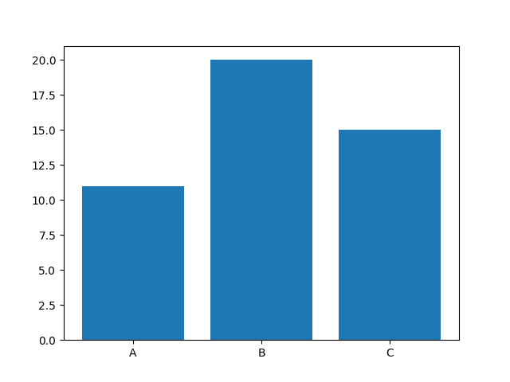
Bar Charts :
Example Code
A bar chart represents categorical data using bars.
import matplotlib.pyplot as plt
categories = ['A', 'B', ‘C’]
values = [11, 20, 15]
plt.bar(categories, values)
plt.show()
The height of each bar shows the value.
Why Bar Charts Exist:
Easy comparison across categories.
Clear visualization of differences.
Output
Common Uses:
Sales per product
Students per department
Survey results

Slide 8
Customizing Plots
Customization improves readability and clarity.
Common Customizations:
Why Customization Matters:
Titles
Axis labels
Legends
Grids
Makes plots presentation-ready.
Helps viewers understand the message clearly.

Slide 9
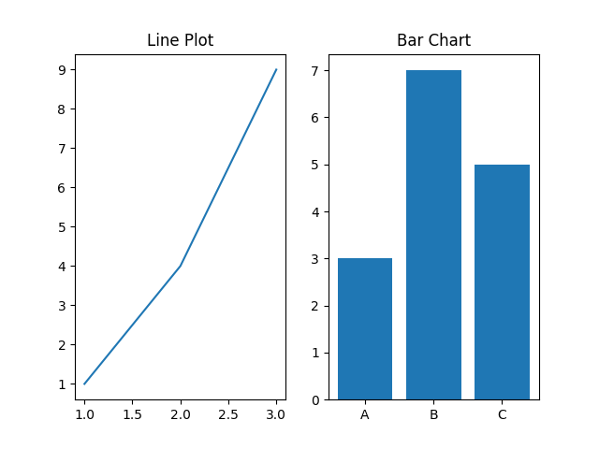
Subplots
Example code:
Subplots allow multiple plots in a single figure.
import matplotlib.pyplot as plt
plt.subplot(1, 2, 1)
plt.plot([1,2,3], [1,4,9])
plt.title("Line Plot")
plt.subplot(1, 2, 2)
plt.bar(['A','B','C'], [3,7,5])
plt.title("Bar Chart")
plt.show()
Useful for comparing different visualizations side by side.
Applications:
Comparative analysis
Dashboard-style layouts
Output :

Slide 10
Thank You!
Presented by Tech Kares

